Slide 1



AN 80,000 WORD THESIS
WOULD TAKE 9 HOURS TO PRESENT.
YOUR TIME LIMIT.... 3 MINUTES!
UMD THREE-MINUTE THESIS COMPETITION
Register to compete by February 28, 2024
Register HERE
The Three Minute Thesis (3MT®) is an academic competition developed by
The University of Queensland (UQ), Australia for research students.

Slide 2
What is 3MT?
The University of Queensland (UQ)
First developed by the University of Queensland in 2008, The Three Minute Thesis competition (3MT®) challenges research students to communicate the significance of their projects to a non-specialist audience in just three minutes.

Slide 3
Why do a 3MT?
Develop your communication Skills
Practice how to effectively explain your research in language appropriate to a non-specialist audience.
Build research culture in the university
Use this experience as an opportunity to come together with peers (live or virtually), get to know one another, and talk about your research in a supportive environment.
Build external relations
Prepare a 3MT to improve or enhance your networking and professional development opportunities.

Slide 4

History of the 3MT
At a time when the state of Queensland was suffering severe drought, residents were encouraged to time their showers, and many people had a three-minute egg timer fixed to the wall in their bathroom.
The Dean of the UQ Graduate School put two and two together and the idea for the 3MT competition was born.
UMD SUCCESS in the U21 International 3MT Video Competition
2014 – Amy Marquardt, Materials Science and Engineering (First Prize, People’s Choice)
2015 – Carly Muletz Wolz, Biological Sciences (People’s Choice)
2017 – Sammy Ramsey, Entomology (First Prize, People’s Choice)

Slide 5
University of Maryland
3MT Competition
First-Round College-Level
College-level competitions occur in March
5 college-level competitions:
  CMNS
  ENGR
  ARHU-BSOS
  AGNR-BMGT-PLCY-SPHL
  ARCH-EDUC-INFO-JOUR
The college-level competitions will be a video competition but may have an in-person component.
Each college-level competition can advance students to compete as Semi-Finalists in the Final-Round.
College-Level prizes are determined by the college(s)
Final-Round Campus-Level
Final round will be held on April 17, 2024.
Up to 20 Semi-Finalists will compete in the Final Round.
An interdisciplinary panel will name up to six Campus-Level winners.
Campus-level winners will receive a $1000 prize and professional production of their 3MT presentation. Six winners will be named.
UMD Competition is open to master’s, pre-candidacy, and post-candidacy students
Register to compete HERE by February 28, 2024
3MT Website: gradschool.umd.edu/funding/student-fellowships-awards/umd-three-minute-thesis-competition

Slide 6
3MT Rules
https://threeminutethesis.uq.edu.au/virtual-competition-rules
A single static PowerPoint slide
No additional electronic media (e.g. sound and video files)
No additional props (e.g. costumes, musical instruments, laboratory equipment)
No edits
Presentations are limited to 3 minutes
Presentations are to be spoken word (e.g. no poems, raps or songs).

Slide 7
3MT Judging Criteria
https://threeminutethesis.uq.edu.au/resources/judging-criteria
  Provide some background and explain significance
  Present to a non-specialist audience and follow a clear
  and logical sequence
  Describe the key results, if applicable
  Convey enthusiasm for research and make the audience
  want to know more!
  Have stage presence!

Slide 8
Resources available to students
3MT Workshops
Graduate School Writing Center: Make an appointment with Dr. Linda Macri or an Oral Communications Fellow at the Graduate School Writing Center for brainstorming, feedback, and guidance on your 3MT.
One Button Studios: Use one of the One Button Studios located across campus to help make a 3MT recording.
Your 3MT college-level contact: Your college-level contact may be able to provide guidance as you prepare your 3MT.

Slide 9
Important Dates for 3MT
February 28: Deadline to register to compete
(Register HERE)
March 6: First-round 3MT Video and 3MT slide are due (most first-round competitions will be video competitions)
Mar 6 - 31: College-Level First-Round Competitions held
Apr 1 - Apr 16: Semi-finalists prepare for the Final-Round
April 17: Final-Round 3MT Presentations (in-Person)

Slide 10
Three-Minute Thesis Workshop
Linda C. Macri, Ph.D.
Director
Graduate School Writing Center
Spring 2024
Notes:
Introduction to the competition but also to the idea of delivering your research in a succinct, accessible way –
The contest got its start in Australia in 2008, and three years later the University of British Columbia became the first North American university to adopt the concept. The competition has caught on across Canada: dozens of universities held 3MT contests this spring. Ontario and Quebec have come up with the idea of provincials, and in the next year or so there could well be nationals.
From AAS: This scientific version of the elevator pitch is intended to celebrate doctoral research, hone participants’ communication skills, and disseminate research to the public.
The idea is NOT to simplify your ideas, but to flex your communication muscles – you should be able to talk about your research in a sentence, in three minutes, in an introduction, in an article, in 300 pages – so, this afternoon, we’ll talk a bit about ways to do that – I’ll talk specifically about the 3MT competition at Maryland, but, more broadly, about ways to make your research engaging and accessible to an interndisciplinary audience – like you have to at Thanksgiving, and like you’ll have to at a job interview –
Today we are going to focus on introducing the idea and getting some general understading of this GENRE – we won’t focus on the visuals and we won’t focus very much on the presentation – but those are two really important elements of ANY presentation – so if you think you would be interested in those as well, let me know – there will be an evaluation for you to let us know
We are joined today by two people who have done very different version of these videos – and I am very grateful that they are here to help us start to dive into understanding this way of communicating your research
So let me introduce Sammy Ramsey,, a doctoral candidate in Entomology and last year’s Maryland 3MT winner – he also went on to win the U21 competition – and that’s all I’ll say about him because You are going to hear about his research from him, – and let me also introduce Prof. Jason Farman, Director of the Design Cultures & Creativity Program, an Associate Professor in the Department of American Studies, and a faculty member with the Human-Computer Interaction Lab at the University of Maryland, College Park – and again, that’s all I’ll say abou this research because you’ll hear more about it from him in a minute –We are going to watch Carly’s winning 3MT video and a video focusing on Jason’s research and recent book, part of a series from ARHU promoting the work of humanities faculty – as you watch, I’m going to ask that you pay attention to what each aims to do how they do it, what they might have in common, what’s effective

Slide 11
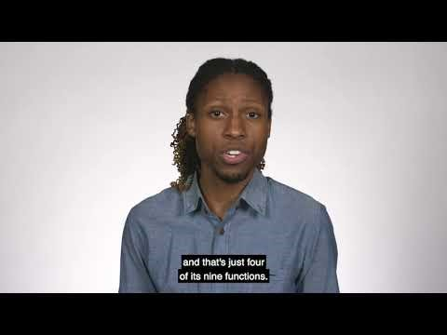
Sammy Ramsey, Entomology

Slide 12
The Rhetorical Situation
Rhetorical Situation = the situation that shapes the argument and the potential of the argument
What’s in that situation?
  Audience
  Speaker/author
  Purpose
  Constraints (word limit, medium, etc.)
  The particular moment/exigence

Slide 13
Audience
For 3MT – knowledgeable, academic, cross-disciplinary
  So what does that mean about how to talk to them?
Interdisciplinary, academic

Slide 14
Audience
What does that mean you do – and don’t – have to tell them?
What do people IN your discipline know that people OUTSIDE your discipline don’t know?
  Terminology
  Context (background, why the problem matters, how it has been addressed in the past, etc.)

Slide 15
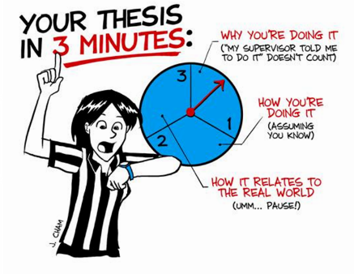
Constraints
Notes:
The biggest constraint is TIME -- in the details, it also has to be one take, not read, etc.

Slide 16
Constraints
One slide, no animation
3 minutes
One take

Slide 17
Purpose
What is your purpose in these three minutes?
  Explain?
  Persuade?
  Make them remember – pique their curiosity.

Slide 18
Simple Rules for Success
Change the world
Make me care
Be passionate

Slide 19
Simple Rules for Success
Change the world
Start with the big picture, a broad context
Help your audience see that there is a problem (even if the problem isn’t at the top of their list) (create exigence)
THEN explain how you are contributing to a solution

Slide 20
Simple Rules for Success
Make me care
  The audience needs to relate to the issue in order to follow the delivery
  Your audience has a broad capacity for caring—but you have to help develop it
Notes:
Think about this – within your discipline, this “caring” is covered because you share interests, etc. Here, in an audience beyond your discipline, you need to create that sense of interest, concern, caring

Slide 21
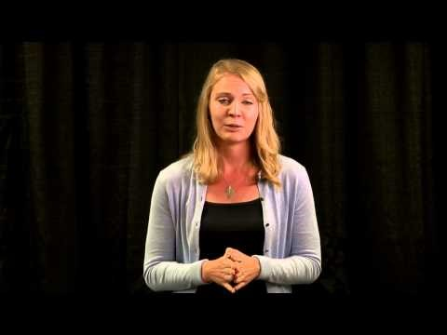
Amy Marquardt,
Material Science Engineering, 2014 Winner

Slide 22


Slide 23
Simple Rules for Success
Be passionate
If you aren’t excited, why should I be?
Notes:
But all of this seems like it means that there are ideas out there that are better suited – climate change, medical breakthroughs, etc. – yes, but no --

Slide 24
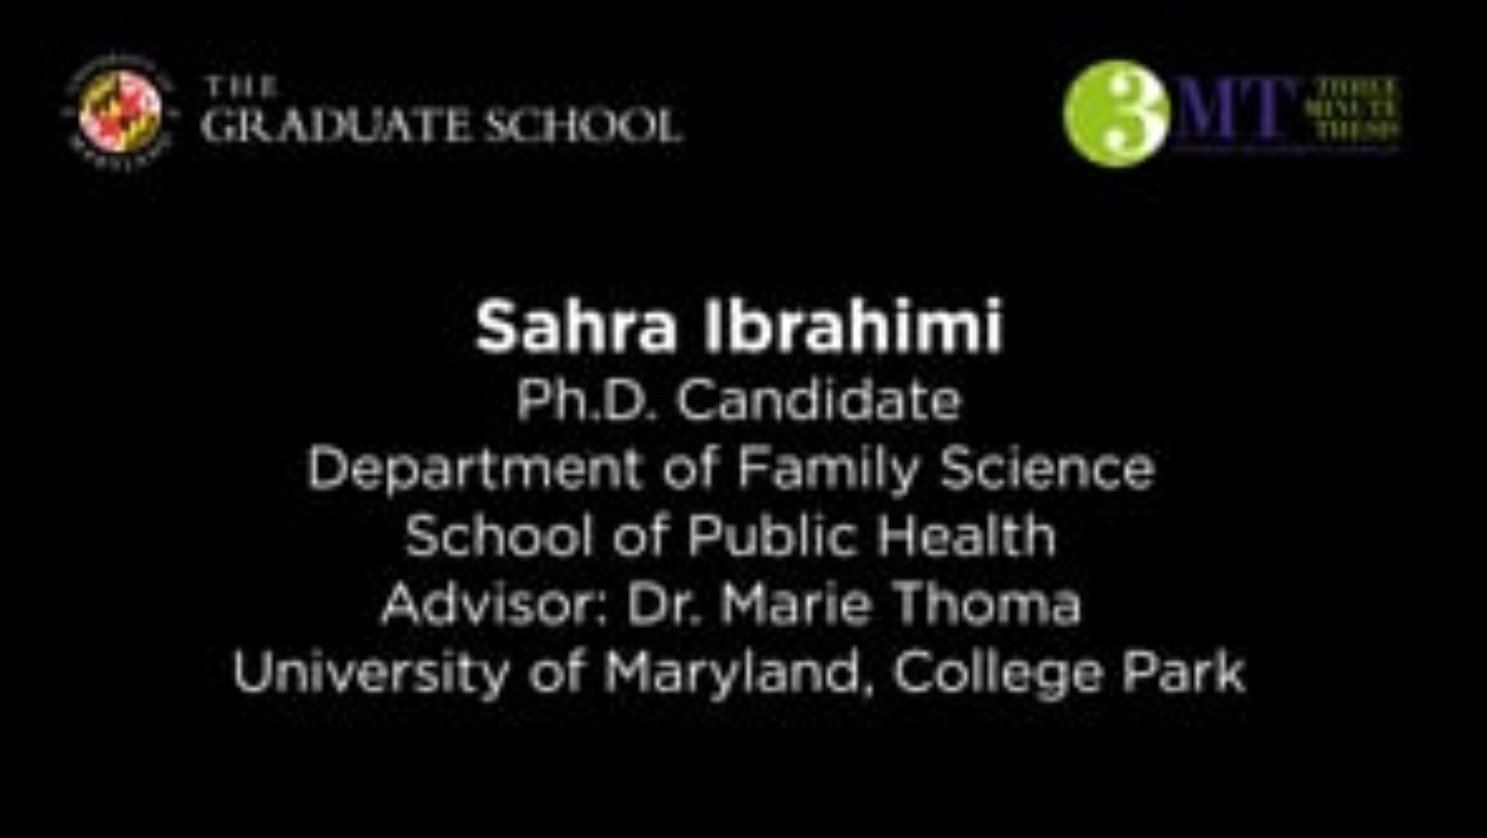
Sahra Ibrahimi
Maternal & Child Health
https://vimeo.com/876376462

Slide 25
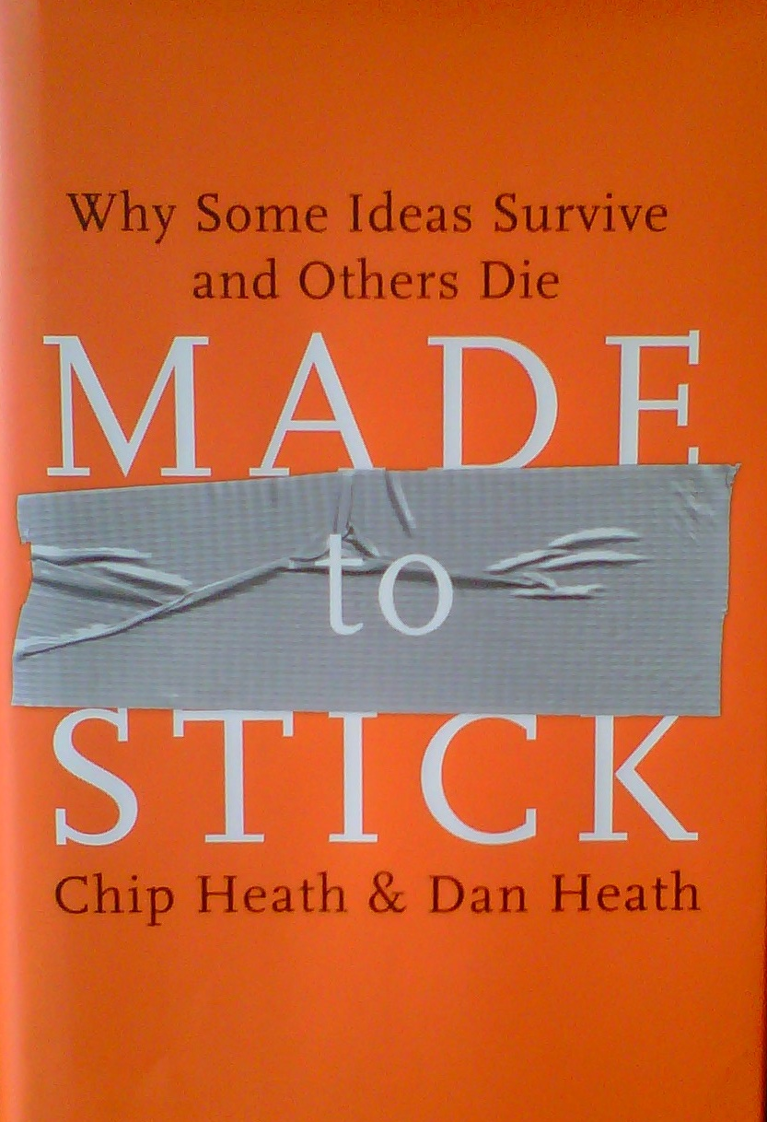
“It’s the nature versus nurture debate applied to ideas: Are ideas born interesting or made interesting?” (5)
Notes:
Simple – but not simplistic or dumbed down
Unexpected
Concrete
Credible
Emotional – not the same as manipulative
Stories – we follow narratives for a reason

Slide 26
Center for Science in the Public Interest & movie popcorn
A medium sized movie popcorn contains 37 grams of saturated fat, twice the recommended daily amount of saturated fat.
Notes:
Simple – but not simplistic or dumbed down
Unexpected
Concrete
Credible
Emotional – not the same as manipulative
Stories – we follow narratives for a reason

Slide 27
Center for Science in the Public Interest & movie popcorn
“A medium-sized ‘butter’ popcorn at a typical neighborhood movie theater contains more artery-clogging fat than a bacon-and-eggs breakfast, a Big Mac and fries for lunch, and a steak dinner with all the trimmings—combined!”
Notes:
Simple – but not simplistic or dumbed down
Unexpected
Concrete
Credible
Emotional – not the same as manipulative
Stories – we follow narratives for a reason

Slide 28
Made to Stick
Simple
Unexpected
Concrete
Credible
Emotional
Stories
Notes:
Simple – but not simplistic or dumbed down
Unexpected
Concrete
Credible
Emotional – not the same as manipulative
Stories – we follow narratives for a reason

Slide 29
Simple
Not simplistic, not dumbed down. But the CORE of your idea.
  Limited, focused
  Often, you have to know the complex idea to make it simple (but not to make it dumb).

Slide 30
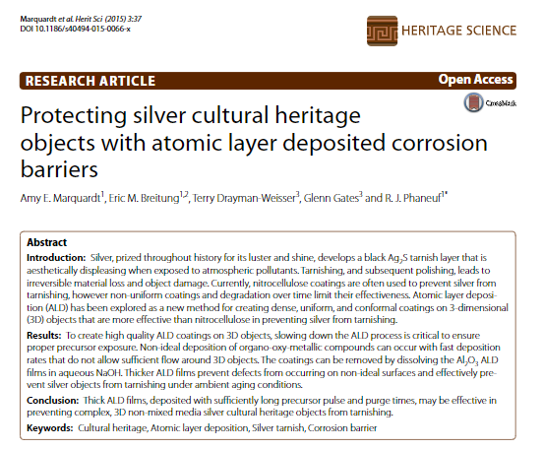
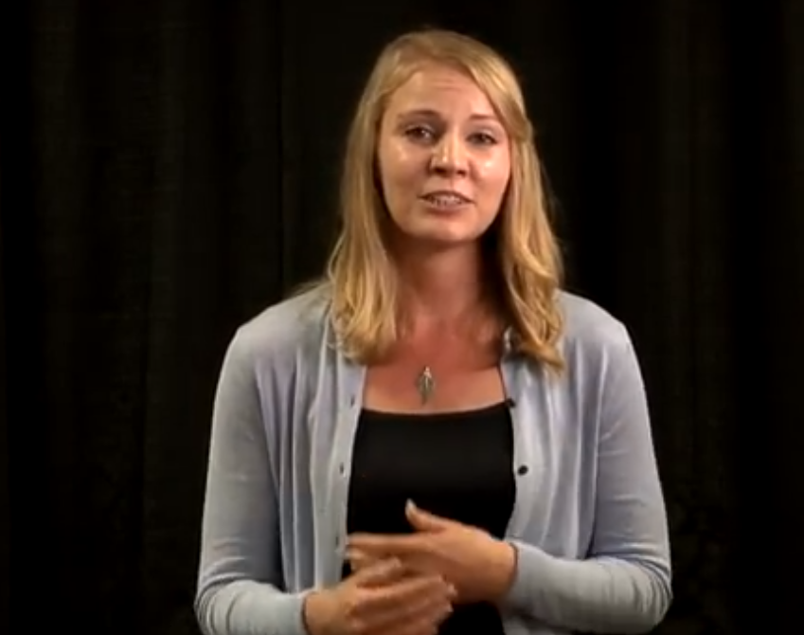
Complex v. Simple
Published Research
3MT
Notes:
I found that the ceramic ALD films lasted
02:07
about 15 times longer than the plastic coatings.
02:11
That's a huge improvement.

Slide 31
Complex v. Simple
Our recent work demonstrates that ALD films are a promising technique to prevent damage from the corrosion process, and subsequent polishing, for silver cultural heritage objects. Our previous results find that 20 nm Al2O3 ALD films protect silver from tarnishing nearly 15 times longer than microns-thick nitrocellulose films: this amounts to a potential ambient effective film lifetime of 150 years.
I found that the ceramic ALD films lasted about 15 times longer than the plastic coatings.
2:07-2:11

Slide 32
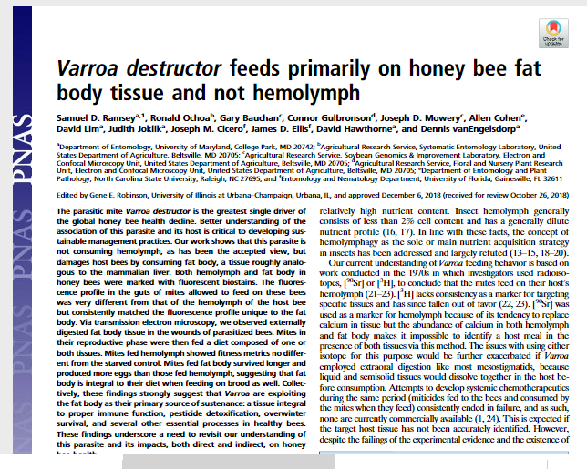
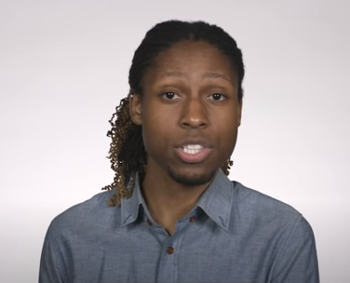
Complex v. Simple
Published Research
3MT
Ramsey, S. D., Ochoa, R., Bauchan, G., Gulbronson, C., Mowery, J. D., Cohen, A., ... & Hawthorne, D. (2019). Varroa destructor feeds primarily on honey bee fat body tissue and not hemolymph. Proceedings of the National Academy of Sciences, 116(5), 1792-1801.

Slide 33
Complex v. Simple
Moreover, determination of the primary source of nutrition for Varroa would change our understanding of the etiology of this parasite and could potentially lead to the development of novel—and of active interest—more effective treatment strategies (e.g., systemic pesticide formulations, interfering RNA, and so forth). To that aim, we conducted a three-tiered study asking the following questions: (i) Do so called phoretic Varroa feed primarily or exclusively in proximity to the fat body?
“ . . .the goal was to figure out what varroa is eating. I started with the question where do they feed? If they can feed anywhere on a bee, the way that a tick can on you, then they're probably feeding on blood. However, if they feed only in one spot maybe they're eating a tissue specific to that location.

Slide 34
Complex v. Simple
Moreover, determination of the primary source of nutrition for Varroa would change our understanding of the etiology of this parasite and could potentially lead to the development of novel—and of active interest—more effective treatment strategies (e.g., systemic pesticide formulations, interfering RNA, and so forth). To that aim, we conducted a three-tiered study asking the following questions: (i) Do so called phoretic Varroa feed primarily or exclusively in proximity to the fat body?
“ . . .the goal was to figure out what varroa is eating. I started with the question where do they feed? If they can feed anywhere on a bee, the way that a tick can on you, then they're probably feeding on blood. However, if they feed only in one spot maybe they're eating a tissue specific to that location.

Slide 35
The Unexpected
“Instead of sucking out your blood, it’s liquefying one of your internal organs.”
“We are covered with microbes”

Slide 36
The Unexpected
There’s probably something so familiar to you that you have forgotten it’s interesting
Tell a neighbor the most interesting thing about your research

Slide 37
Abstract/Concrete
What in your work is abstract? Should it and could it be more concrete?
What in your work is very concrete, specific, maybe even applicable in only one situation? Can you discuss it it more abstract, or broadly applicable, terms?

Slide 38
Abstract/Concrete
Effective speakers “climb up and down the ladder of abstraction”
Roy Peter Clark Writing Tools: 50 Essential Strategies for Every Writer.
Notes:
http://sixminutes.dlugan.com/ladder-abstraction/

Slide 39
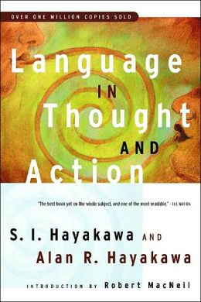
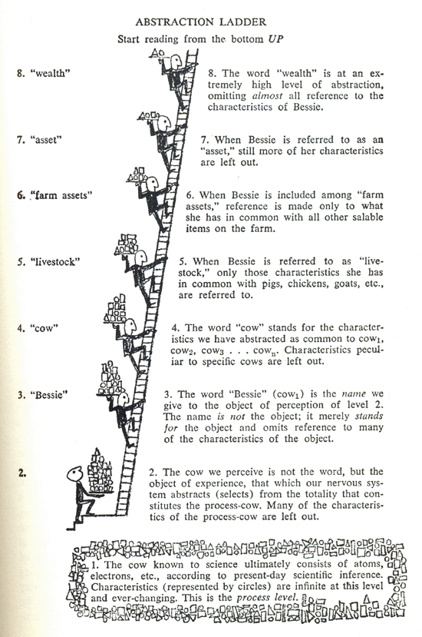

Slide 40
WEALTH
LIVESTOCK
BESSIE, MY COW

Slide 41
Making concepts more concrete
Sequencing an explanation
  Explaining how a phenomenon occurs/occurred
    How did it start?
    What happens/happened next?
    And what happens/happened after that/what results?
  Explaining HOW something works
    What is it used for?
    What does each part do?
    How do parts work together?

Slide 42
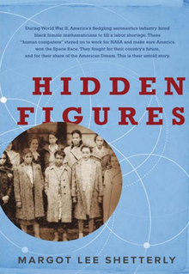
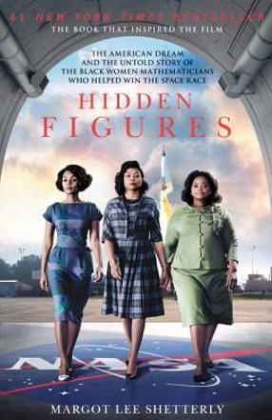
METAPHORS make ideas more concrete
Explaining the aerospace research that took place at NACA during World War II, before NASA existed.
Long before a plane was sent into production, it was tested at NACA for “drag cleanup.”
The concern was about uneven wing geometry.
Explain why that would be a problem? You’ve all flown. . . .
“Did the plane roll unexpectedly? Did it stall? Was it hard to maneuver, resisting the pilot like a shopping cart with a bad wheel.”

Slide 43
Emotional
Emotions ≠ tears
  Pathos – appeal to the concerns of the audience
  Why should your audience CARE
Notes:
http://sixminutes.dlugan.com/ladder-abstraction/

Slide 44
Stories
Characters/actors (not necessarily human)
Challenges/a quest
Some kind of tension about whether the characters will succeed or fail in the challenges
A beginning, middle, end
Notes:
We are storytelling animals; we like things with a narrative, we don’t just like them, we remember stories better. But how do you tell a story about . . . .your research? What elements do stories have -- all these tell us WHAT’s THE POINT

Slide 45
The Slide
Persuade with the image: what do you need to explain that your words can’t fully convey
  Illustrate
  Explain a process
  Offer data – graphic representation of results
  Offer analysis or causality
  Tie things together
But not all of that!

Slide 46
Spoken v. Written Prose
You are speaking these presentations. So to compose, don’t just write them, but speak them.
Notes:
How to write these – one answer is don’t write them – speak them. Because there are differences between how we write and how we speak, and these are definitely spoken, not read, then it makes sense to speak them in your invention stage – not write them – so use the memo recorder on your phone, talk them out to people

Slide 47
Using Questions
You may have been told not to use questions in academic writing -- but this isn’t academic writing.
Questions engage
Do you remember the answer to this:
“But why care about woodland salamanders and their microbes?”
Were you compelled to wonder about the answer?

Slide 48
Known-New
Readers expect to get familiar information first then new information.
That’s an expectation, not a rule.
Known-new contract

Slide 49
I started with the question where do they feed.
If they can feed anywhere on a bee, the way that a tick can on you, then they're probably feeding on blood. However if they feed only in one spot, maybe they're eating a tissue specific to that location. The results? They feed only in one spot, on the underside of the bees abdomen. The tissue in this area is called the fat body and this is significant because the fat body doesn't just store nutrients it detoxifies pesticides regulates hormone levels it produces the honeybee’s primary immune response to microbial invaders and that's just four of its nine functions.

Slide 50
I started with the question where do they feed.
If they can feed anywhere on a bee, the way that a tick can on you, then they're probably feeding on blood. However if they feed only in one spot, maybe they're eating a tissue specific to that location. The results? They feed only in one spot, on the underside of the bees abdomen. The tissue in this area is called the fat body and this is significant because the fat body doesn't just store nutrients. It detoxifies pesticides regulates hormone levels it produces the honeybee’s primary immune response to microbial invaders and that's just four of its nine functions.

Slide 51
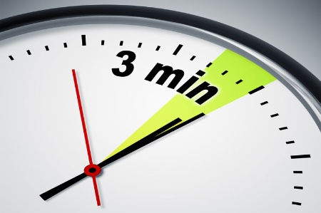
Questions?

